Slide 1
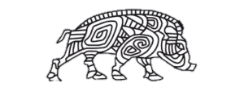
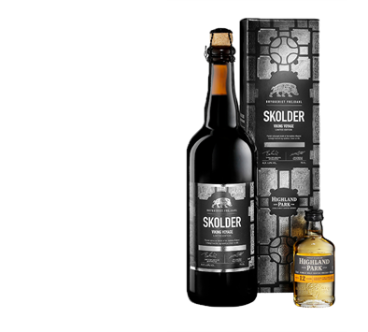
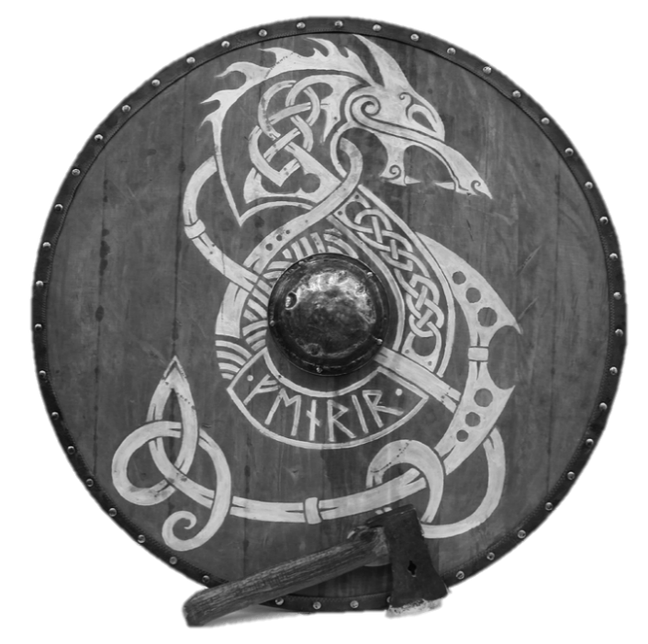
Frejdahl-Bryggeriet vestfyen
Baldur

Slide 2
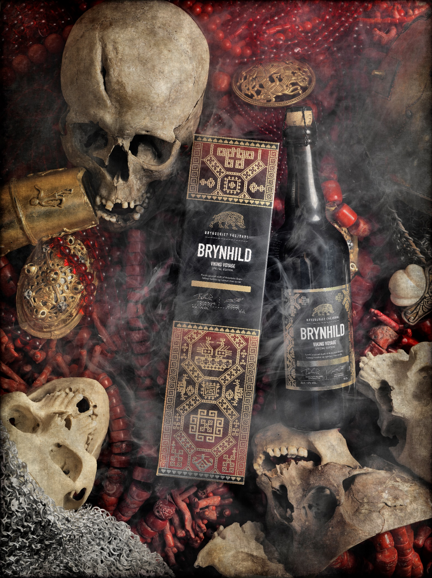

Summary
Business Goal
Core Story
Persona & Target Group
Moodboard
Marketing Strategy
Relevance to the Users

Slide 3


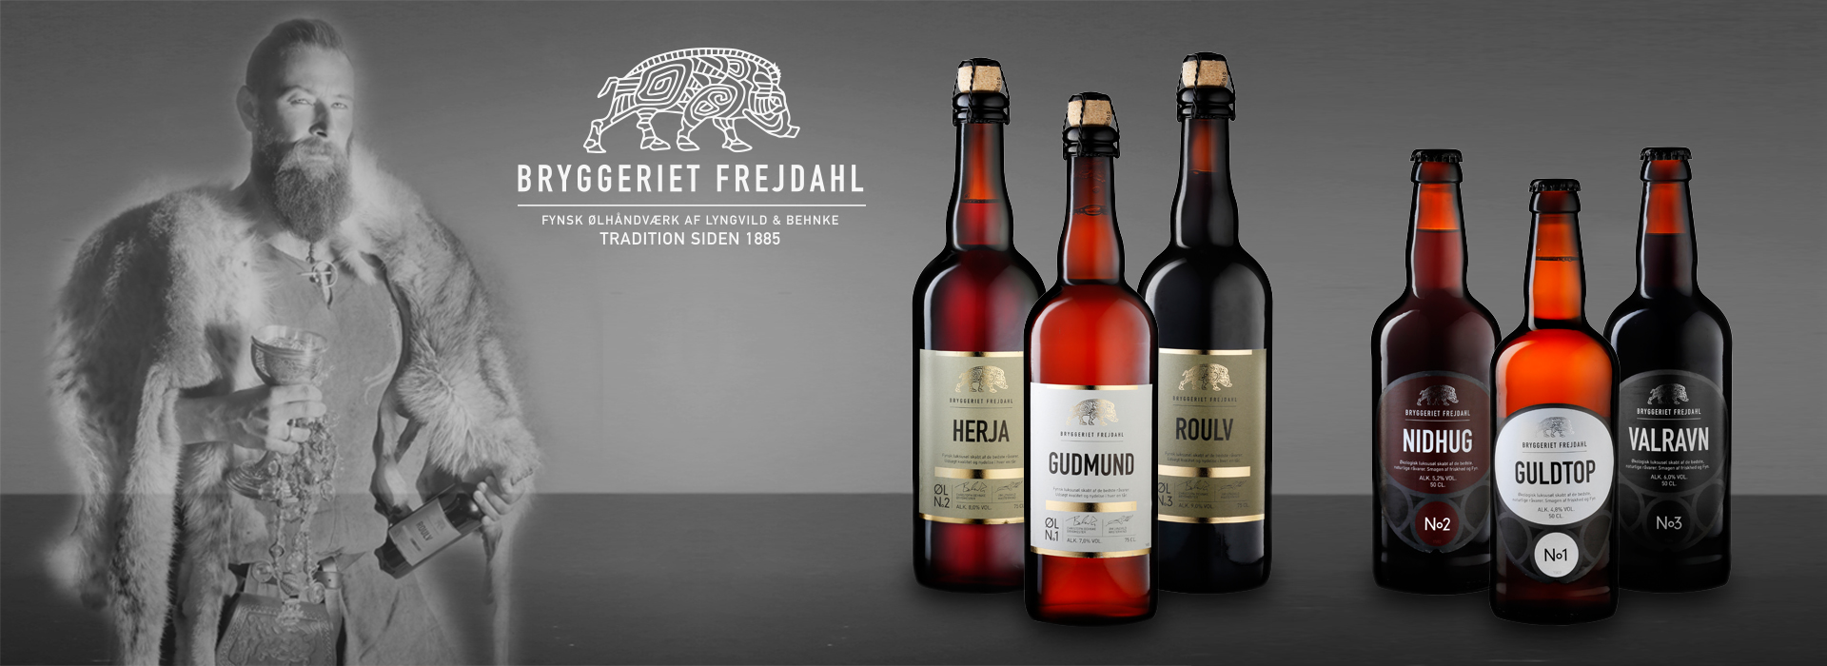
Goal
To engage the customers in the Frejdahl brand by using a digital media

Slide 4
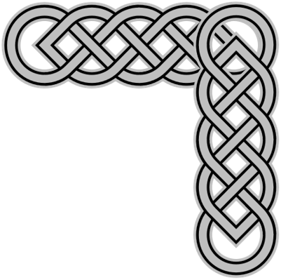
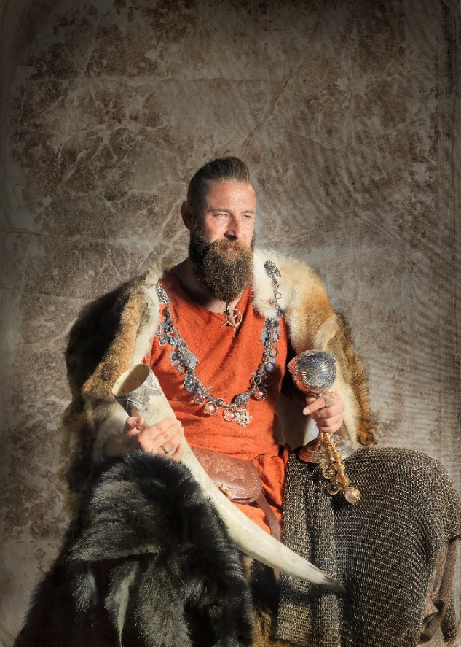
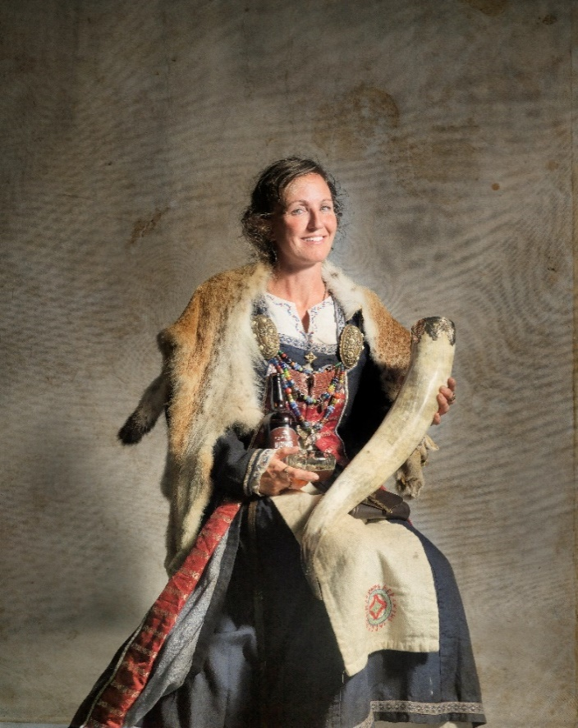
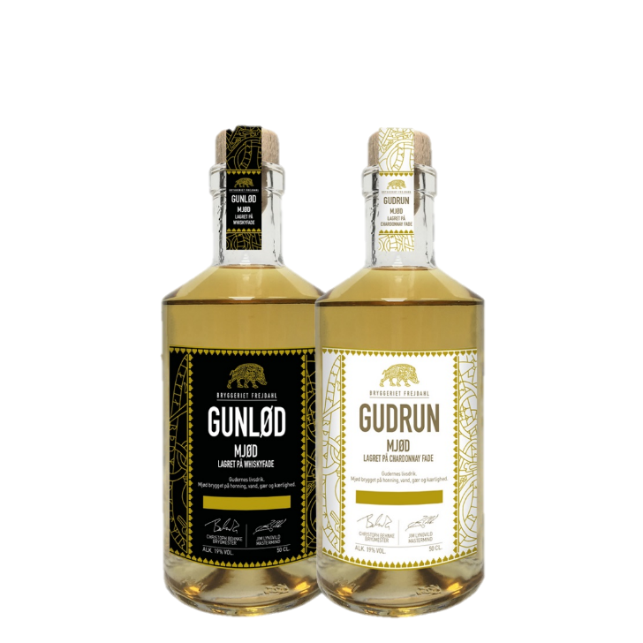
Core Story
Learn how to brew mead like Vikings through a story
Story before the beer
Social media

Slide 5
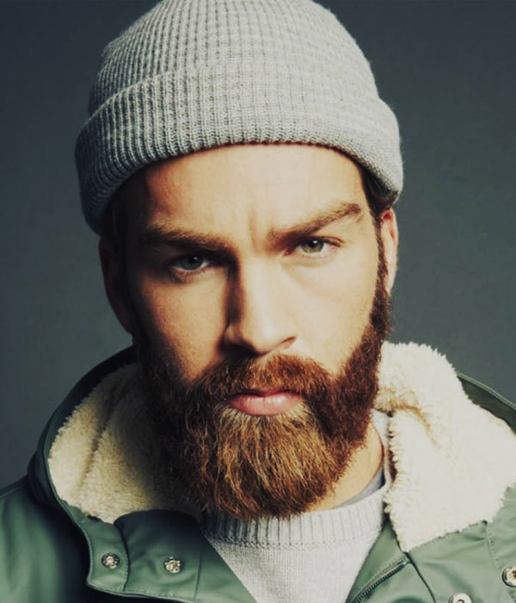
Lars Frejdahl
Comfort With Technology
About
INTERNET
Age: 24
Residence: denmark
Education: highschool
Occupation: student
Marital status: in a relationship
Software
Mobile apps
Tagline
Social network
“The viking life chose me”
Fears
Needs
Afraid of being ordinary
Needs to educate himself every day
Every day should be a little different
Wants
Values
Enjoys to eat out, and have a
nice drink to his meal
Quality over quantity
Never stop learning

Slide 6
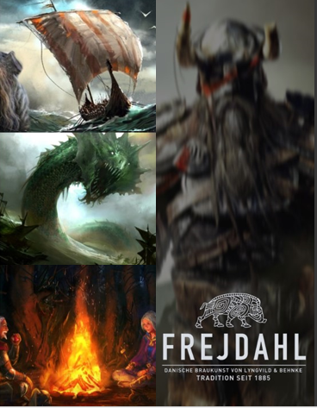
Moodboard
Dragons
Dark and gritty
Posh, eloquent
Warm viking spirit
Campfire
Beer
Friendship
Lust for battle

Slide 7

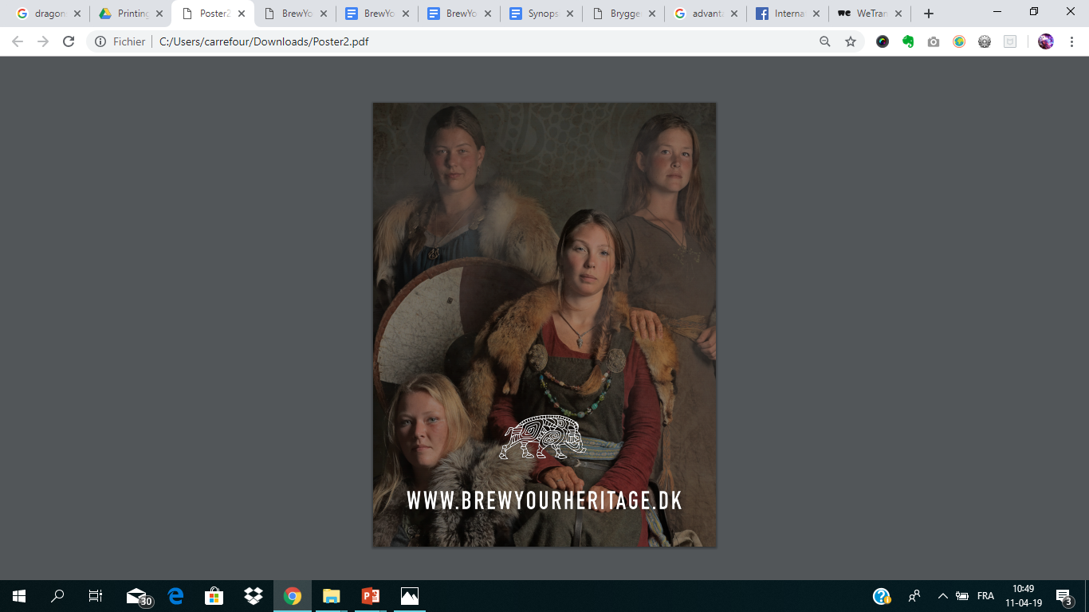
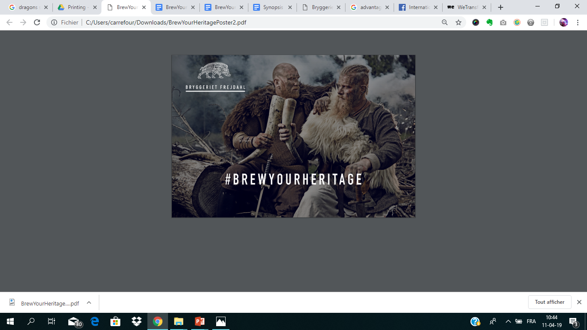
Marketing Strategy
Promotion via social media
#VikingChallenge
#BrewYourHeritage
Website

Slide 8

Relevance to the Users
Enthusiasts can learn to make their own beer, and simultaneously learn about norse mythology
Learn to appreciate the craftsmanship of Frejdahl beer & mead

Slide 9
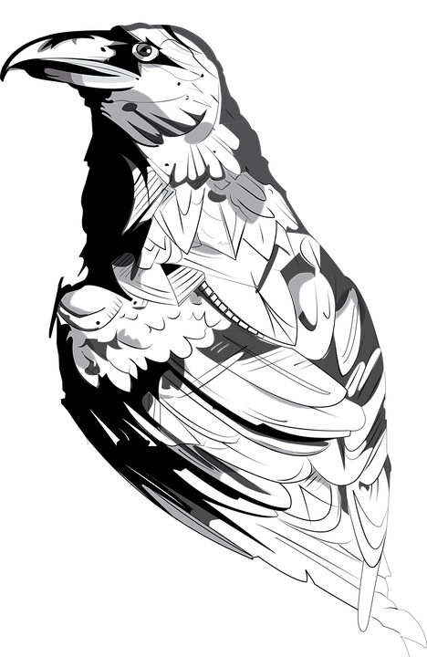
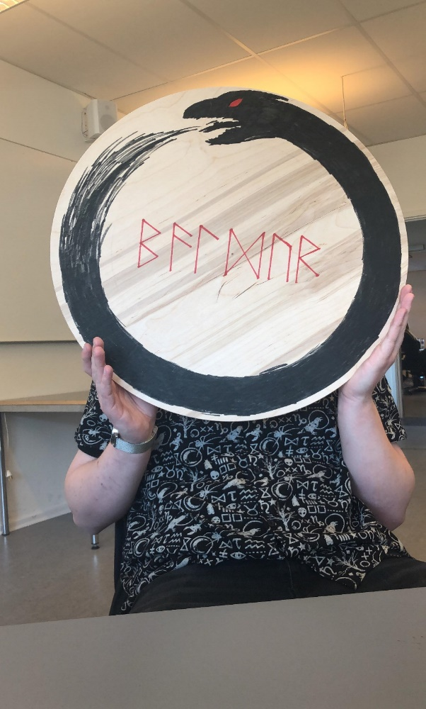
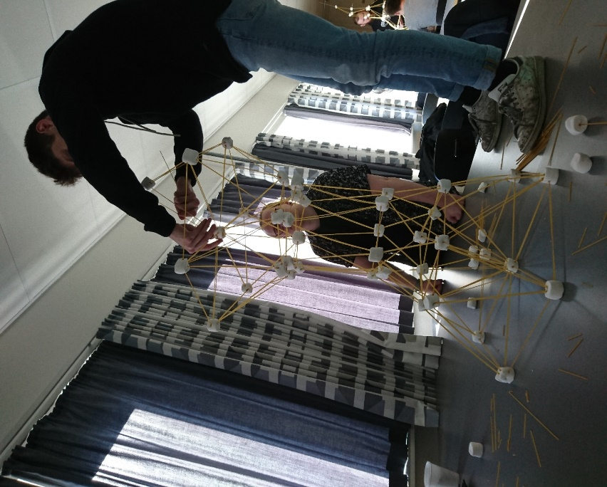
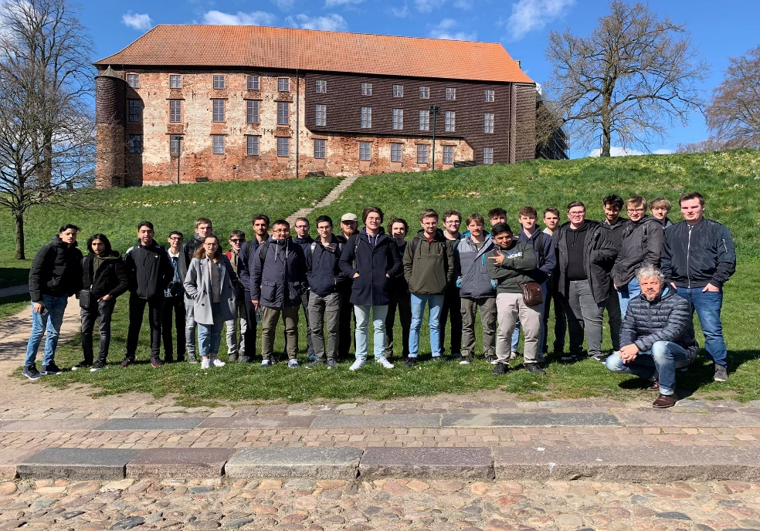
Thank you !

